Slide 1

Project Blink
Proof of Speed - 1.3 Blink, Legates and IHR

Slide 2
Blink
Blink can be called a block. But a Block cannot be called a blink
Blink reference the time interval between the first transaction into the block to the last transaction using VDFs
VDFs are used popularly in Solana Blockchain to timestamp transactions
Blink is a subset of a block, where blink only contains the data and the block contains the data with the space
Here space denotes the empty time interval of unfilled block

Slide 3
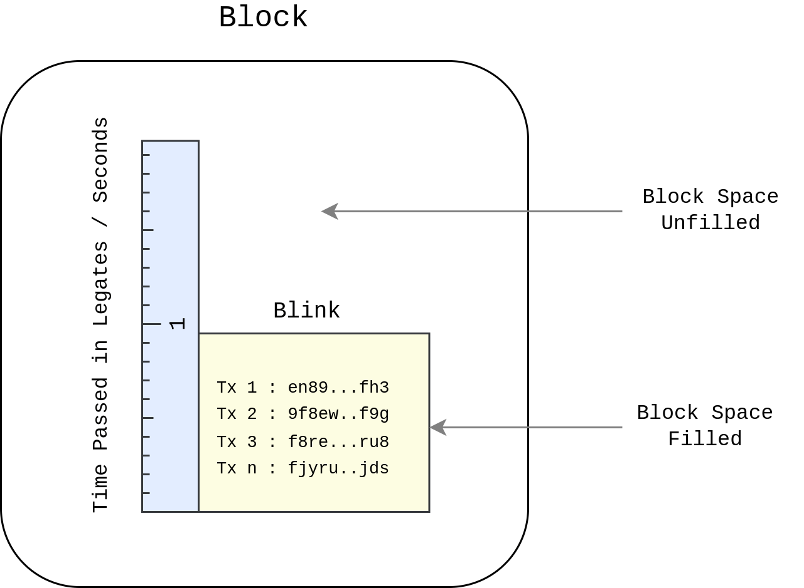

Slide 4
VDFs
VDFs are known as Verifiable Delay Function
A function or an operation is repeatedly carried out in a restricted memory or can be a single threaded operation which can prove that a time has passed cryptographically.
Popularly used in Solana Proof of History
A Hashing Sequence is used in Blinkchain inside blinks to prove a time is passed between the transactions

Slide 5
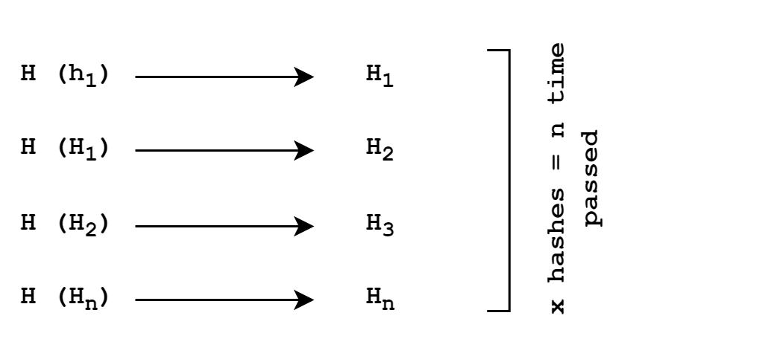

Slide 6
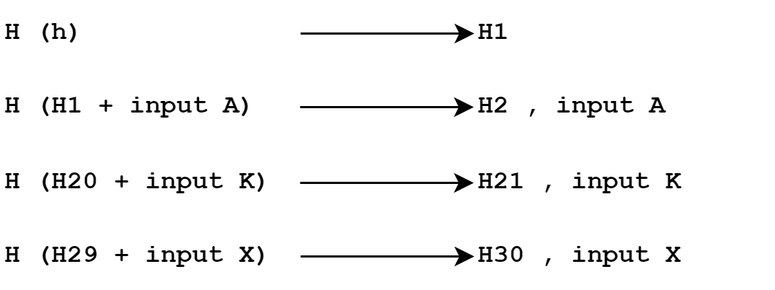

Slide 7
Inside a Blink
Every Blink shall include the hash sequence, it’s pre-images and outputs to validate the time interval passed and the accurate timestamps of transactions
This can prove if there are blink and block spaces
Block space represents the delay in first transaction arrival
Blink space represents the delay in between transactions
The Spaces are found to generate accurate rewards for producers

Slide 8
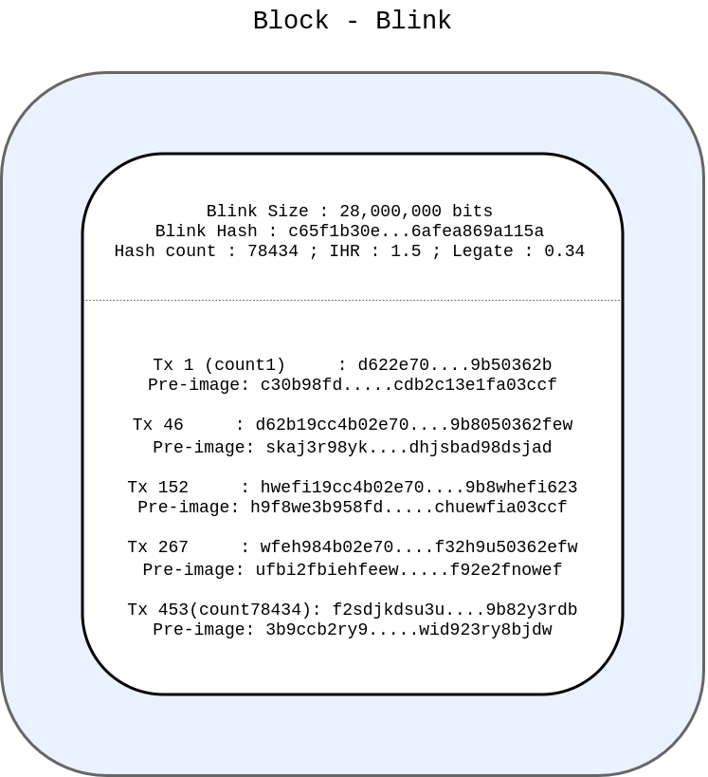

Slide 9
Summary - Blink
The producer shall initiate the hash-sequence locally. When the first transaction arrives, it appends the external data’s hash to the preimage and repeats it until the last transaction
Validators can verify the timestamp, the spaces, the transactions in linear way
It is then gossiped across the network

Slide 10
Different Time on Computers
We have seen that each blink is attached with a hash-sequence created in a single-threaded operation
Each computer or it’s CPU has different hash-rate per second
Hence different time clocks. There need to be a universal time unit to synchronize the different clocks with different hashing speed
Time plays a major role in blinkchain. Time is different in blinkchain. It is expressed not in seconds but in legates

Slide 11

Legate
Original Def : A representative or a delegate
Legate is the basic unit to represent time in blockchain
A Legate represents a commonly used multi-core processor's single thread's hash rate per second (H/s) which can be taken as a legacy hardware hash rate from which other hash rates of different hardware are synchronized.

Slide 12
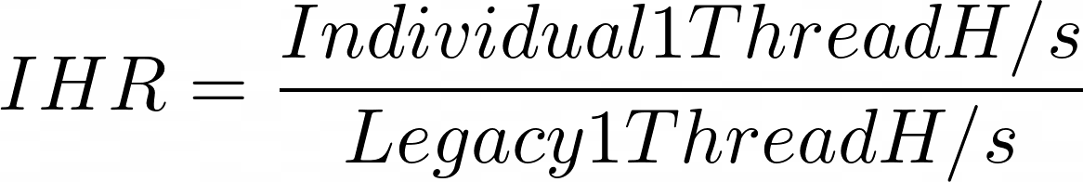
IHR
IHR is known as Individual Hash Rate, a proof attested by producers during block production.
The IHR value is unique to each node and is expressed in multiples of Legates or Legacy hardware’s single thread hash-rate /sec
For Eg Legate = 300 H/s , IHR = 390 ; 250/300; IHR = 1.3

Slide 13
Next : 1.4 Per Block Size and Time

